Slide 1
On the Origin and Future of the Neighbouring Rights
Dr. Rudolf Leška
University of Finance and Administration
Palacký University
ŠTAIDL LEŠKA ADVOKÁTI

Slide 2
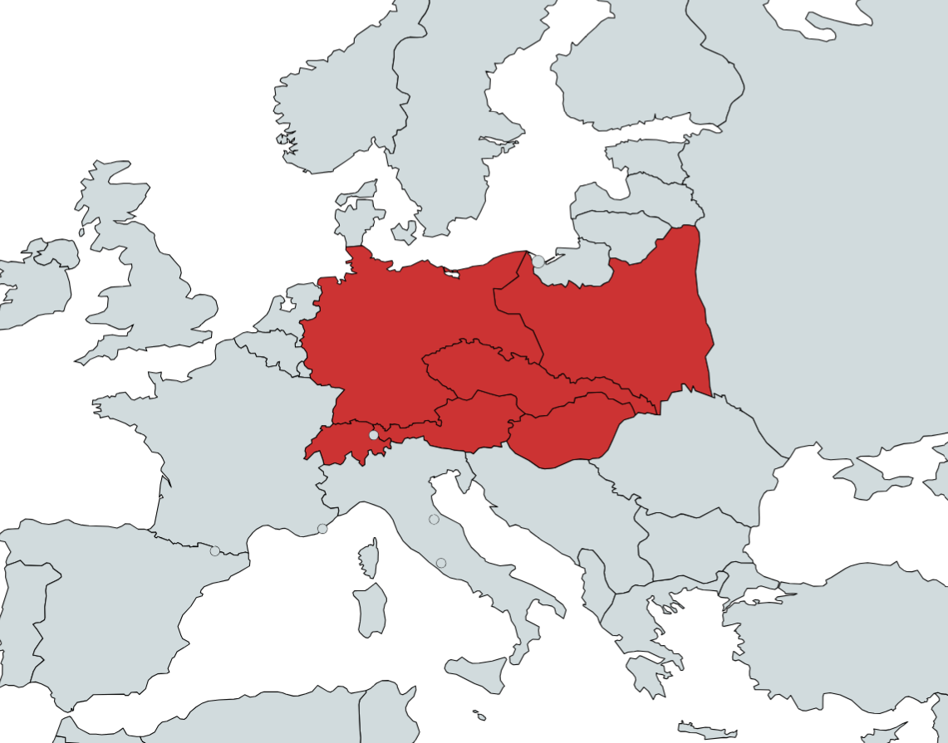
Central European Context
• Shared intellectual and legislative traditions, performances conceptualized as independent immaterial goods
• Performers’ rights born from Central European thought
-- Karel Kadlec, 1892
-- Otto Opet, 1897
-- Landgericht Berlin, Opernsänger 1899 case (GRUR 131, 1900)
• 1928 Rome revision conference

Slide 3
Austria 1936: Birth of Neighboring Rights
• Concept of a sui generis right developer by Alexander Elster (1930) for planned joint German-Austrian copyright law
• 1936 in the Austrian law (recognition of neighbouring rights for performers, phonogram producers)
• Model for Germany (1965) and Italy (1941)
• Rooted in pre‑war Central European legal thought

Slide 4
Exclusive Rights in Communist Law
• Exclusive neighbouring rights for performers, phonogram producers and even broadcasters
• Czechoslovakia 1953, Yugoslavia 1957, GDR (East Germany) 1965, FRG (West Germany) 1965
• Czechoslovakia advocated exclusive rights at 1961 Rome Convention (x UK, France, Italy)

Slide 5
Future?
Rome Convention largely substituted by WPPT, BTAP, Broadcasting treaty (?)
Autonomous Concept of European Union Law? (1992 Rental and Lending Directive)
EU promotes exclusive neighbouring rights via trade agreements
What about the US (Garcia v Google)
Solutions of current challenges to be based on human centered not investment focused approach

